Slide 1
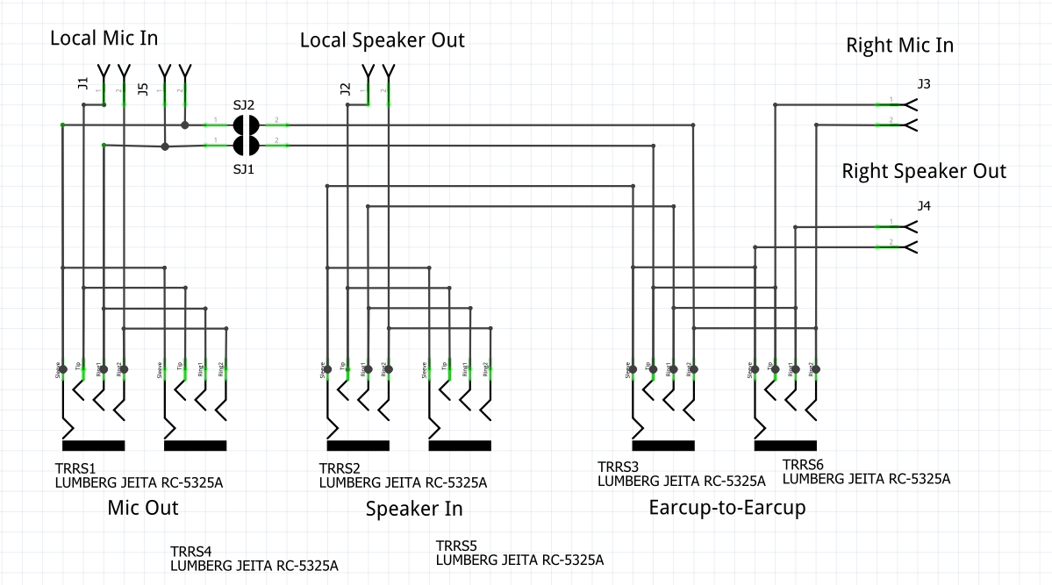

Slide 2
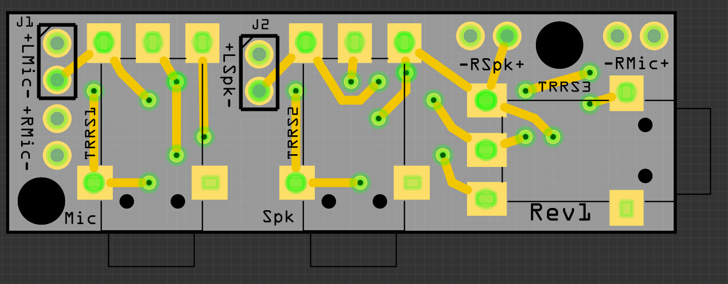
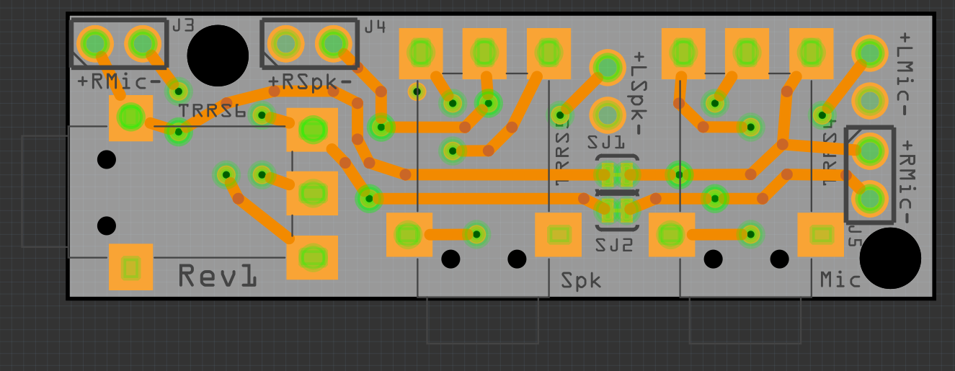
Left Earcup
Jack
Jack
Jack
Right Earcup
Or, you can use these RMic inputs and NOT cut the traces.
Jack
No Jack
No Jack
Cut Traces

